Slide 1
Vocations Workshop Interview Techniques
London School of Theology

Slide 2
We aim to cover
Preparation
Opening question
Types of interview and sample questions
STAR method of reply
On the day

Slide 3
Top skills sought by employers
Verbal communication
Teamwork
Analysing and investigating
Initiative / self-motivation
Written communication
Planning and organisation
Flexibility
Time Management

Slide 4
1) Interview Preparation

Slide 5
PREPARATION
Know Yourself

Slide 6
PREPARATION
Know Yourself
Understand job you’re applying for

Slide 7
PREPARATION
Know Yourself
Understand job you’re applying for
Research the organisation you’re applying to

Slide 8
PREPARATION
Know Yourself
Understand job you’re applying for
Research the organisation you’re applying to
Be ready with informed questions

Slide 9
PREPARATION
Know Yourself
Understand job you’re applying for
Research the organisation you’re applying to
Be ready with informed questions
Prepare sample answers

Slide 10
PREPARATION
Know Yourself
Understand job you’re applying for
Research the organisation you’re applying to
Be ready with informed questions
Prepare sample answers

Slide 11
PREPARATION
Know Yourself
Understand job you’re applying for
Research the organisation you’re applying to
Be ready with informed questions
Prepare sample answers
Practise with mock interview

Slide 12
2) Interview Opening Question and Top 10 Question Areas

Slide 13
2) OPENING QUESTION
Tell us about yourself…..

Slide 14
2) TOP 10 AREAS COVERED IN INTERVIEW
Your skills - The employer
The job - Your ambitions
Your work history - Your motivation
The product/service - Teamworking
You and your interests - Unusual questions

Slide 15
3) DIFFERENT INTERVIEW TYPES AND QUESTIONS
Traditional Interview

Slide 16
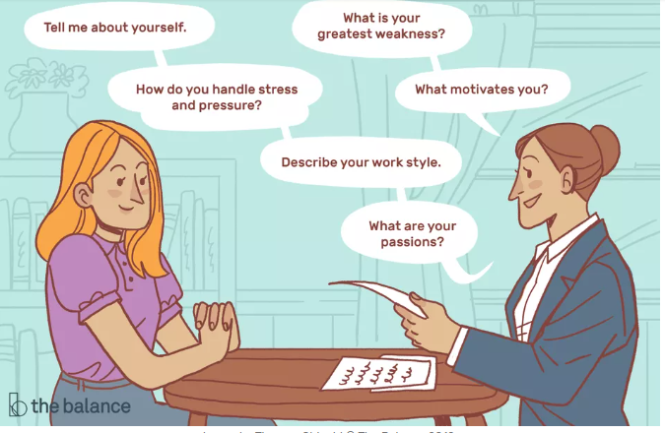
Traditional questions

Slide 17
STAR(E) Technique

Slide 18
3) DIFFERENT INTERVIEW TYPES AND QUESTIONS
Traditional Interview
Behavioural/competency-based

Slide 19
3) DIFFERENT INTERVIEW TYPES AND QUESTIONS
Traditional Interview
Behavioural/competency-based
Situational

Slide 20
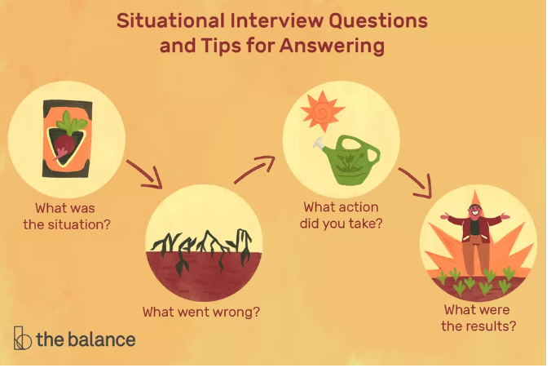
Situational questions

Slide 21
STAR
Breakout
Create a STAR response:
Tell me about a time when you showed leadership skills

Slide 22
5) ON THE DAY
Attire
Logistics and planning
Contact details
Phone/devices
Non-verbal signals

Slide 23
AND FINALLY
Be confident: you’ve been chosen thus far
Remember it’s a 2-way street: you’re interviewing them too
Destress – God’s got this

