Slide 1
Practical Placements and Planning to Serve
London School of Theology

Slide 2
LST Vocational Services
Emily Smuts
Ruth Dowsett

Slide 3
What today’s session covers:
Practical Placement (TH4012 and TM4104)
Informal Placement
Planning to Serve

Slide 4
Attitude in placement:
THINK servant: humble spirit, ready to serve
THINK student: teachable spirit ready to learn
THINK investor: get out of placement what you invest in it.

Slide 5
ETHAN CATHROW
Student experience of placement

Slide 6
Placement activities through October 2020

Slide 7
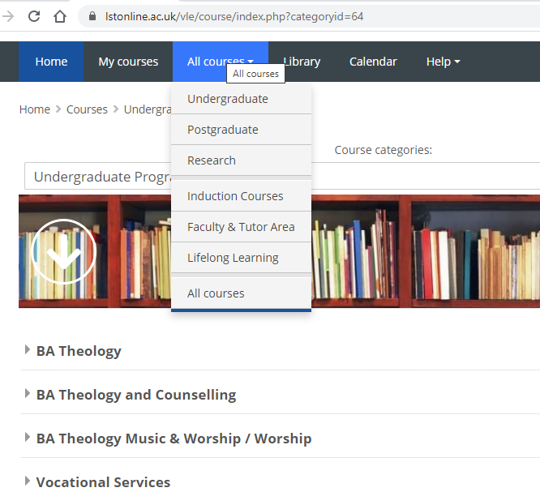
How to access Vocational Services

Slide 8
Informal Placement opportunities

Slide 9
Planning to Serve

Slide 10
Straw poll: do you have any idea of where God is taking you after LST?
None whatsoever
Some clue, which I want to test while I’m here
Clear idea (including retraining)
Here to continue same vocation with greater understanding

Slide 11
What employers are looking for
‘the right mix of skills, abilities and personal qualities - The University of Kent
can-do attitude, enthusiasm, interpersonal skills and the drive and ambition to make an impact - Microsoft UK
work experience, industrial placements and voluntary work - Waitrose

Slide 12
What employers are looking for
“Research shows that some 36% of students completing a work experience placement received at least one definite job offer by the Easter of their final year compared with just 11% of other undergraduates….
Work experience is ‘no longer an optional extra’ for universities and has become an essential element of preparing for the employment market.”
Daily Telegraph, June 2013

Slide 13
An LST mandate
to equip students to respond to the call of God

Slide 14
Planning to Serve programme
Enabling you to become:
ENVISIONED
ENGAGED
EQUIPPED FOR EMPLOYMENT

Slide 15
Planning to Serve in three stages
ENVISIONED: to understand your call and set expectations
Initial self-evaluation questionnaire to create benchmark
Identify practical experience opportunities
Create Personal Development Portfolio

Slide 16
Planning to Serve in three stages
ENGAGED: lay vocational foundations and gain experience
Revisit self-evaluation review PDP
Gifts and skills analysis
Gain work experience
Vocational workshops: know yourself; discern your call and get prepared

Slide 17
Planning to Serve in three stages
EQUIPPED to be sent out
Vocational support workshops and online support
1-1 sessions with Vocational Services (guidance, CV review, applications, mock interviews)
Live job ads

Slide 18
New this year!
ALMA BASE – LST alumni website:
Alumni mentoring programme
Jobs/internships/work experience
Stay connected as LST alumni

Slide 19
Beginning the process
Self-evaluation questionnaire:
https://www.cognitoforms.com/LondonSchoolOfTheology6/SELFEVALUATION

