Slide 1
Making the application
Unmissable CVs and engaging interviews

Slide 2
An unmissable CV

Slide 3
CV TYPES: COMPETENCY-BASED
Personal Statement Education Relevant Skills:
-Statistical Analysis -Communication & Leadership -Organisation
-Problem-Solving -Teamwork - Initiative & Adaptability
Work Experience Volunteering Additional qualifications
Hobbies/Interests

Slide 4
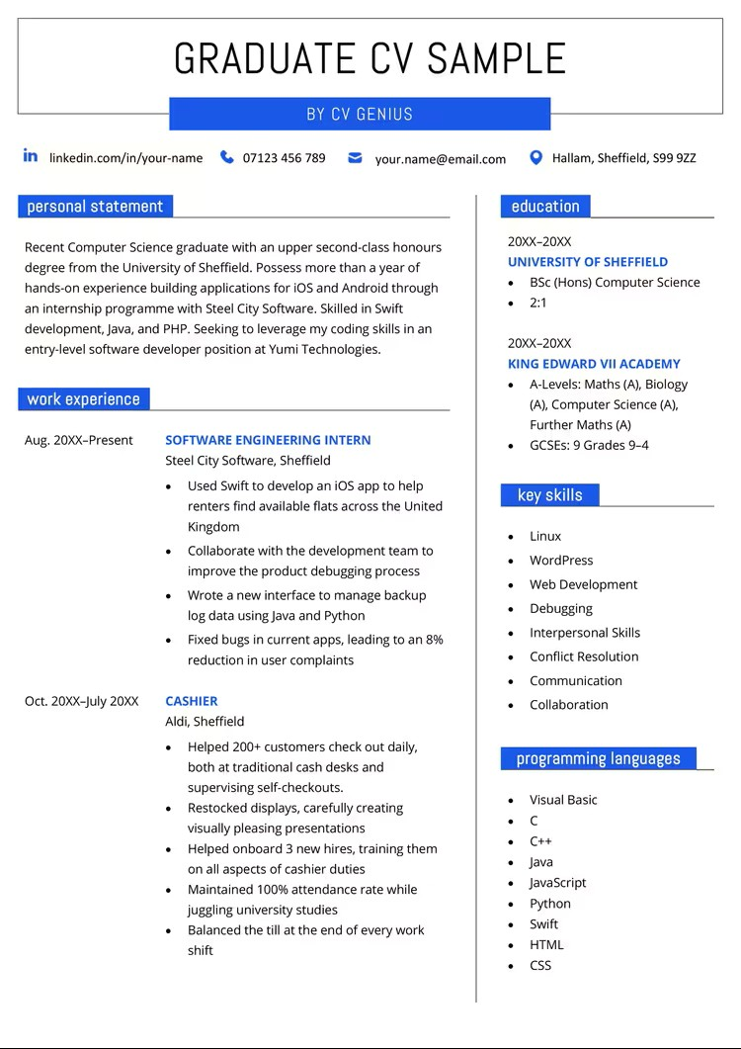
CV TYPES: Reverse chronological

Slide 5
Creating an unmissable CV
Clear, simple format (word)
Match requirements of JD
Create differential
Demonstrate skills: impact, not duties

Slide 6
Personal Statement elements
Sales pitch/ personal brand
main achievements, skills, qualities and experience
Be 3-dimensional: academic, work/ministry and extra-curricular
Build in response to Job Description
Write last

Slide 7
Personal Statement 1
I am a hardworking individual with good communication skills who can adapt to any work environment. I’m flexible adaptible and self-motivated, able to work as an individual or as part of a team. I am reliable, punctual and well organised. I am a quick learner, seeking to learn new skills and develop my existing skills while contributing to the success of a reputable organization such as XX.

Slide 8
Personal Statement 2
High-achieving Education Studies graduate with practical experience working as an Employability Adviser during a recent placement at XX. Confident supporting students and graduates to find employment. Good knowledge of job-searching, applications, CVs, cover letters, interviews and assessments.

Slide 9
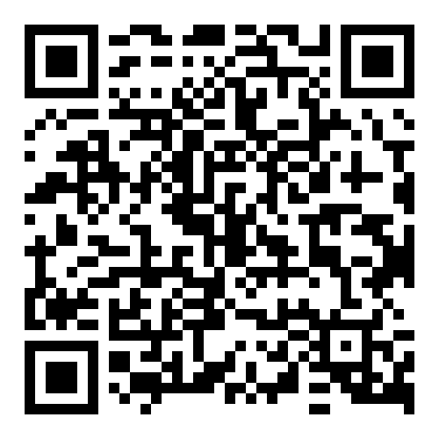
Review CV against Job Description

Slide 10
GROUP WORK: Review CV against Job Description
CV heading: personal information
Personal Statement
Key Skills
How well CV meets Job Tasks
How well CV meets Ideal Candidate
Work Experience/Education
Formatting/Presentation

Slide 11
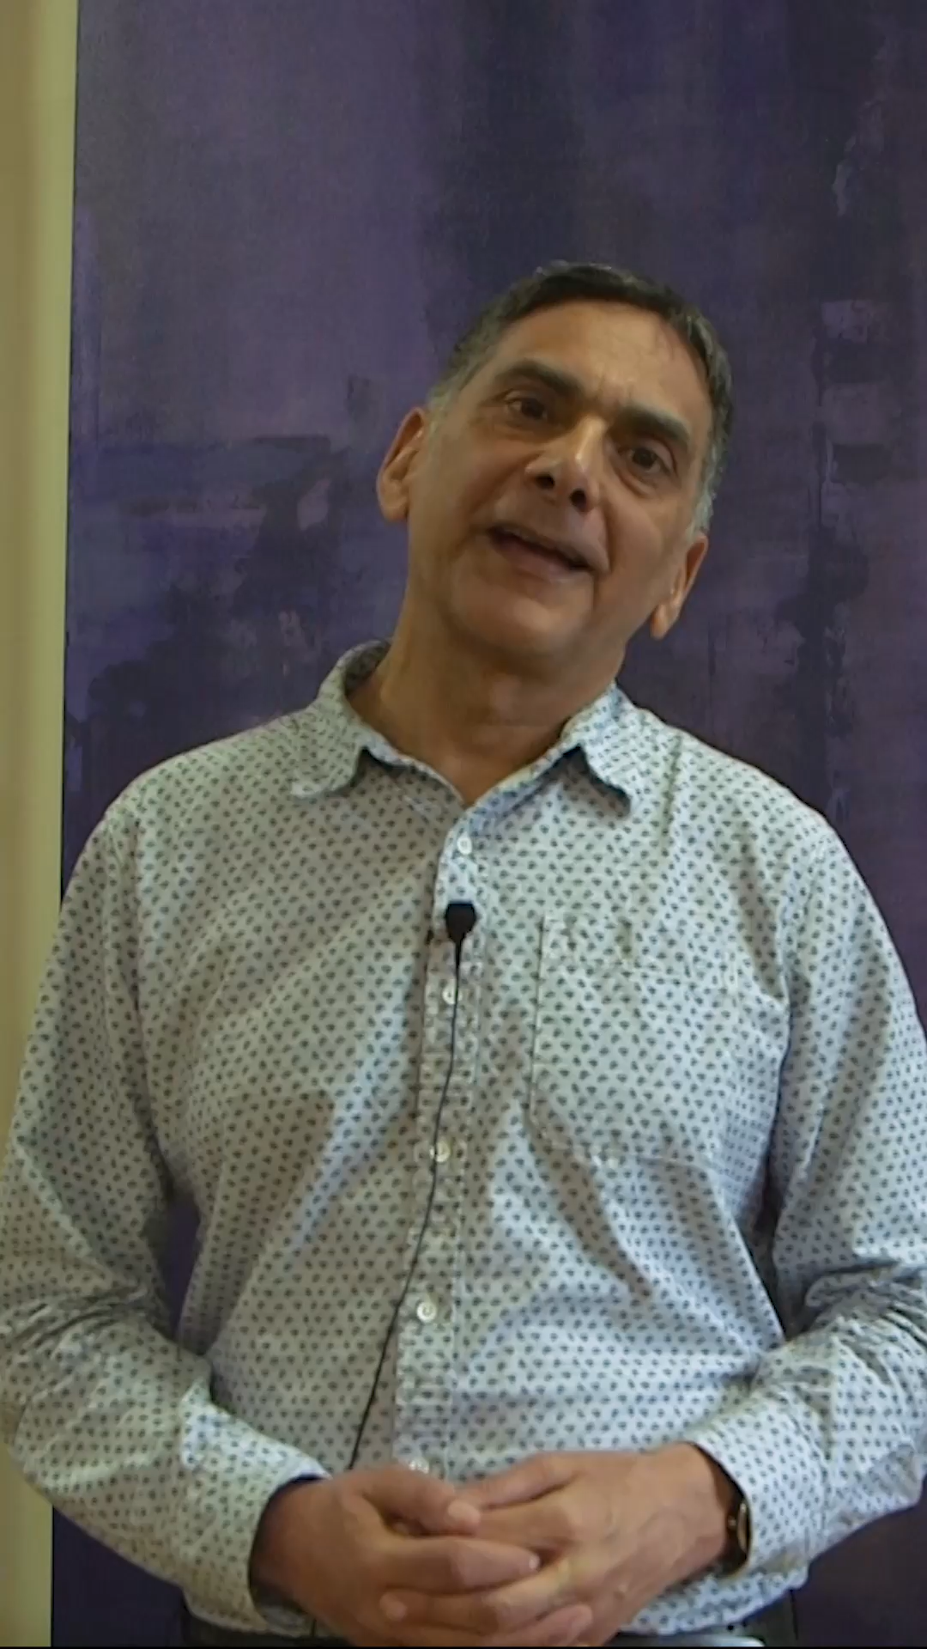
Ken Benjamin, LICC

Slide 12
An engaging interview

Slide 13
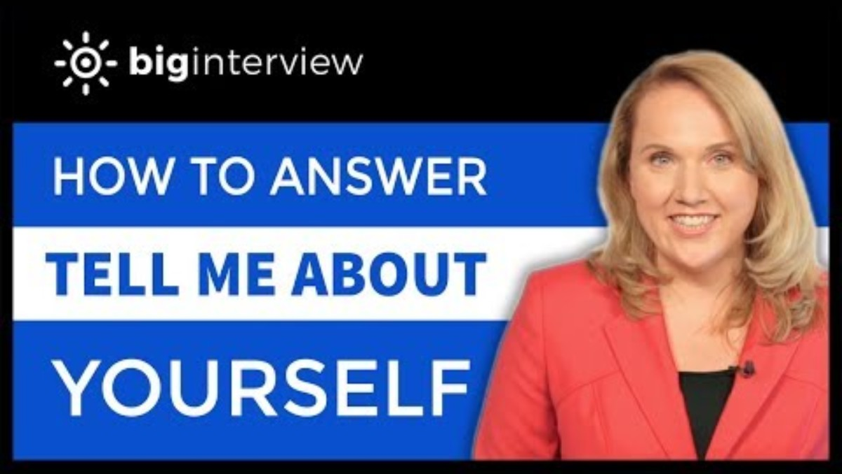
Interview: ‘Tell us about you’ question

Slide 14
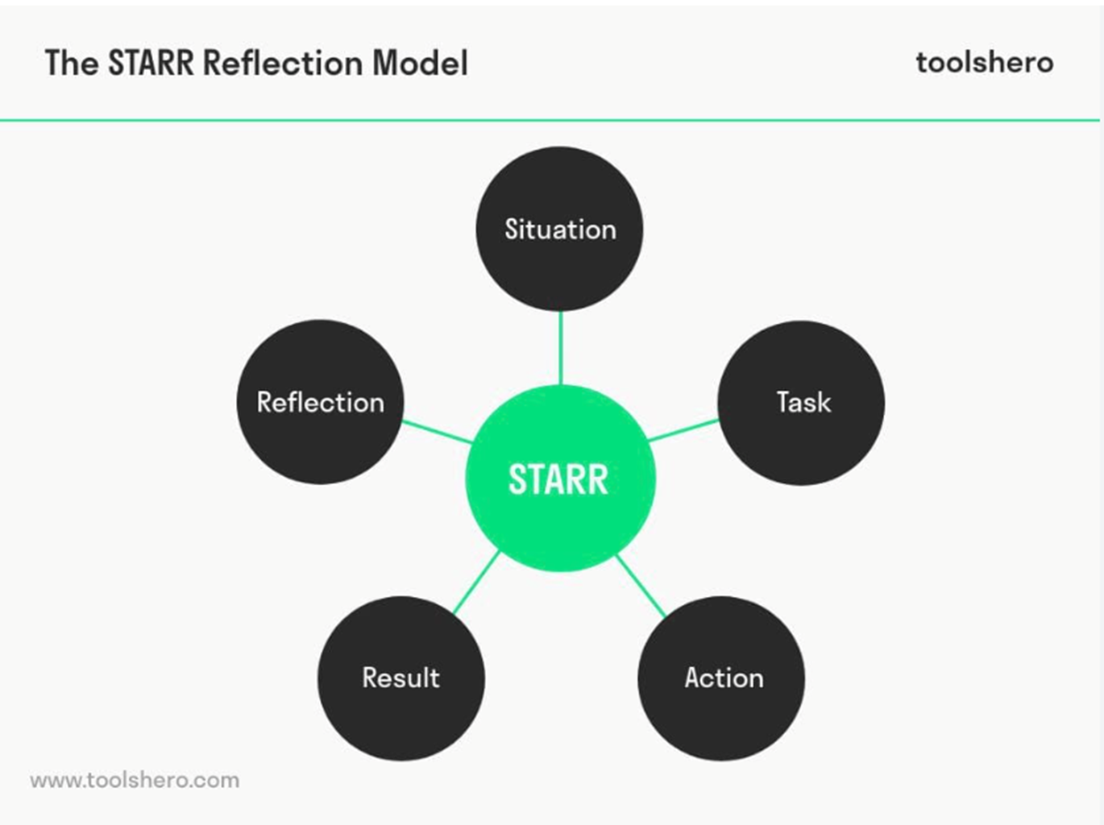
Use STARR method

Slide 15
Competency-based questions
1) Tell us about a time you successfully led or contributed to a team
2) Tell us about a time when you negotiated a good outcome

Slide 16
Top mistakes to avoid
Sending generic CVs
Not answering the question
Weak examples (“I’m hardworking”) with no specifics/evidence
Poor research on company
Lack of confidence / preparation

Slide 17
LST vocational support
1-1 support:
vocational guidance
CV /covering letter review
mock interviews
VLE resources
Almabase live job ads

