Slide 1
Knowing yourself,
Understanding what you bring
London School of Theology

Slide 2
1) KNOW YOURSELF
- Introvert/Extravert?
- What does an introvert/ extravert bring to a team?
Are you a perfectionist?

Slide 3
1) KNOW YOURSELF
- What makes you tick?
- Where will you thrive?

Slide 4
2) UNDERSTAND THE SKILLS YOU BRING TO THE EMPLOYABILITY TABLE

Slide 5
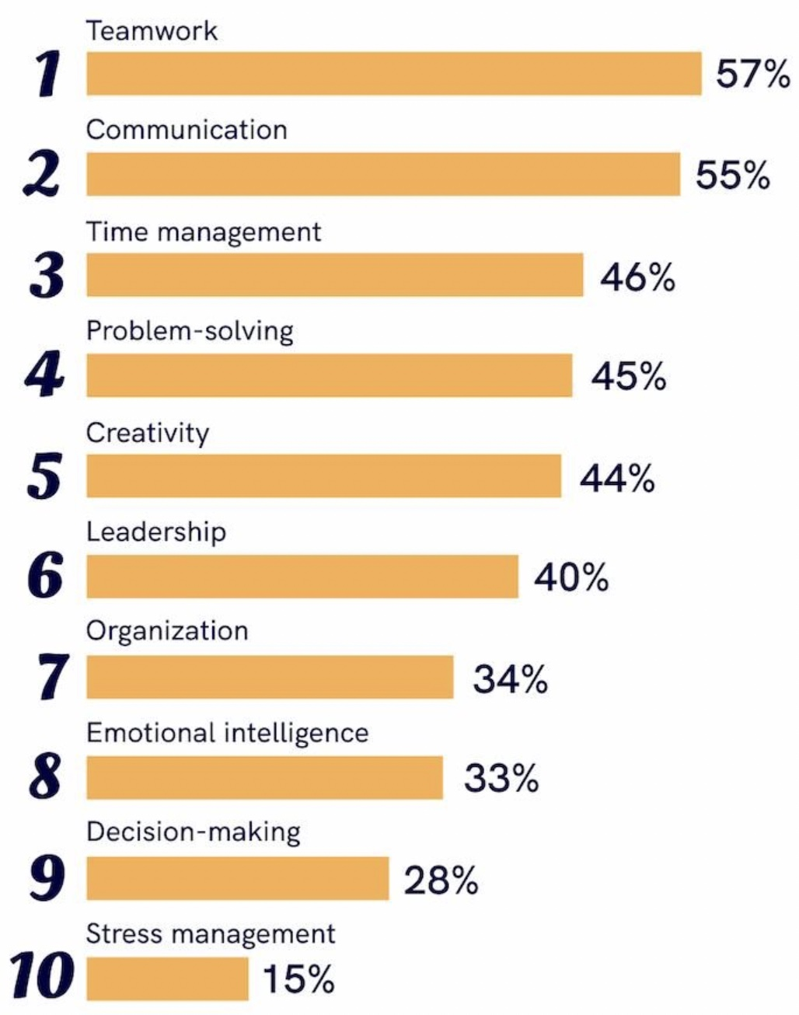
2) Top 10 soft skills sought by employers
By Zety

Slide 6
2) THE SKILLS YOU BRING
Choose one skill
How have you grown in it?
In pairs explain….
Using STARR model

Slide 7
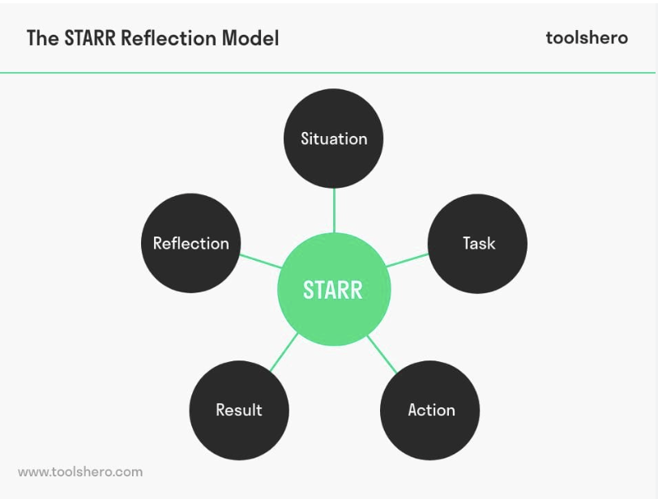

Slide 8
Operations Manager
We’re looking for a highly organized and flexible individual capable of contributing across multiple operational areas—namely HR, IT, Finance, Compliance, and Communications.
The role demands excellent IT and communication skills, both written and oral.
A strong eye for detail is essential for policy management and compliance, ensuring the charity remains legally compliant and delivers its missions safely and efficiently.
This is an interesting and varied role offering scope for creativity. It is suited to someone who can effectively deliver projects, handle finances confidently, and excels at developing processes.

Slide 9
JOB DESCRIPTION REVIEW
does it thrill or horrify you?
what skills does it seek?
prepare competency-based answer for each skill sought

Slide 10
FURTHER EMPLOYABILITY SUPPORT
Cfi offer to run another workshop
2nd Employability workshop:
Wed 22 April, 14.00
Vocational guidance 1-1s

